Slide 1


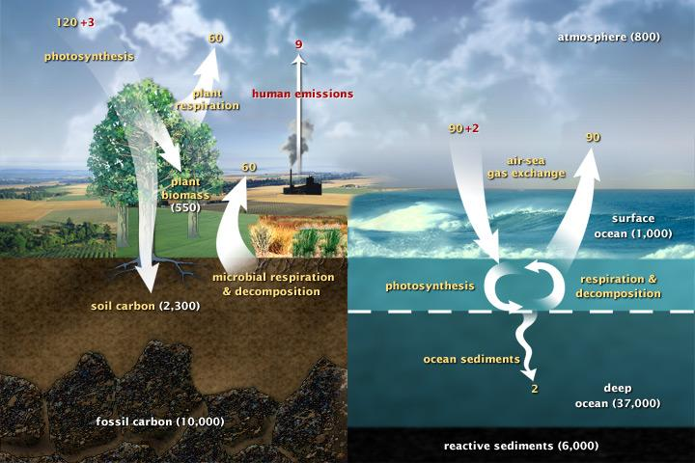
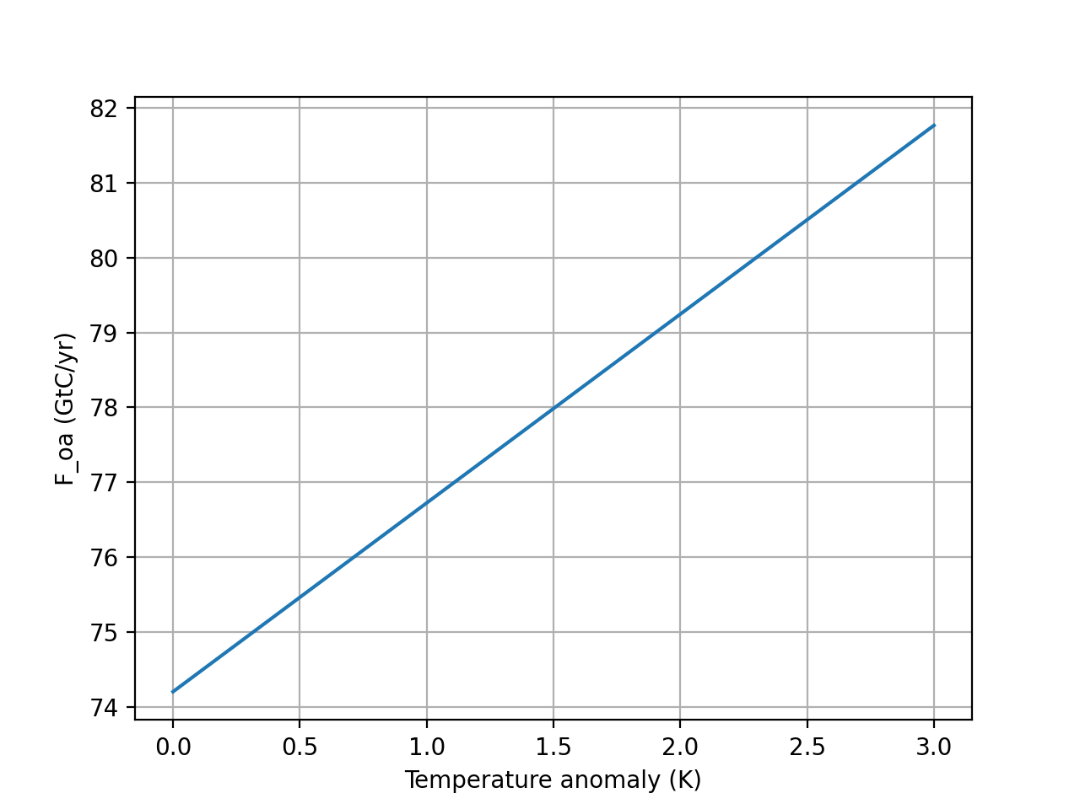

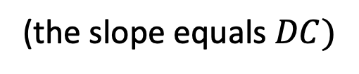

This dependence, whereby gases are less soluble in warmer oceans, is also called Henry’s feedback or (more correctly) van’t Hoff effect.
Cold ocean
Warm ocean

Slide 2
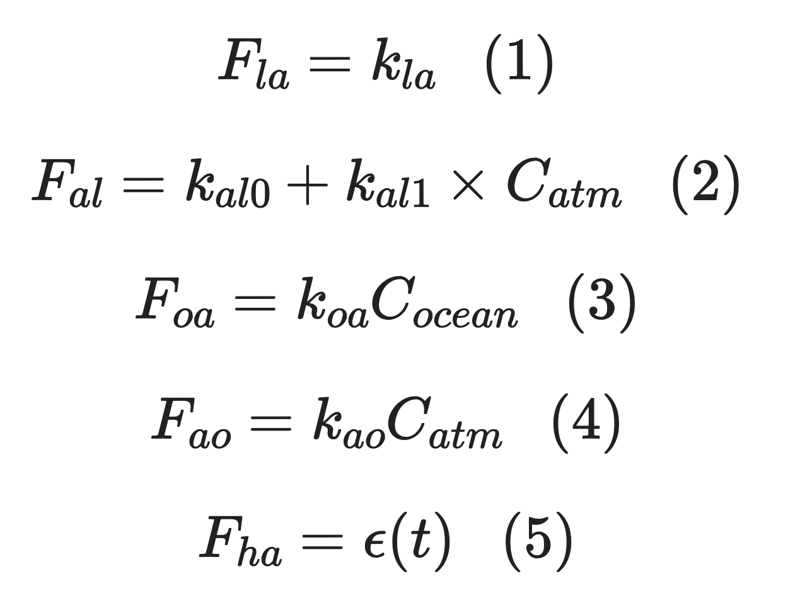

Here are our old (Cambio 1.0) equations of motion
Cold ocean
Warm ocean

Slide 3
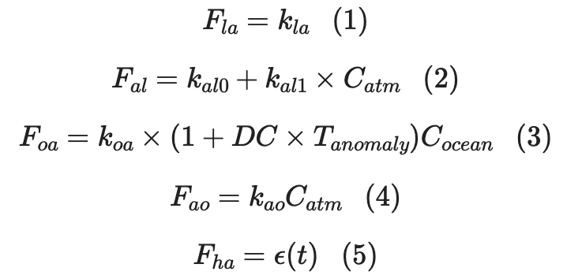
And here are our new (Cambio 2.0) equations of motion
Cold ocean
Warm ocean
In doing so, T_{anomaly} transitions from a diagnostic variable (strictly a result) to a prognostic variable (still a result, but now also a changer of future outcomes)

Slide 4
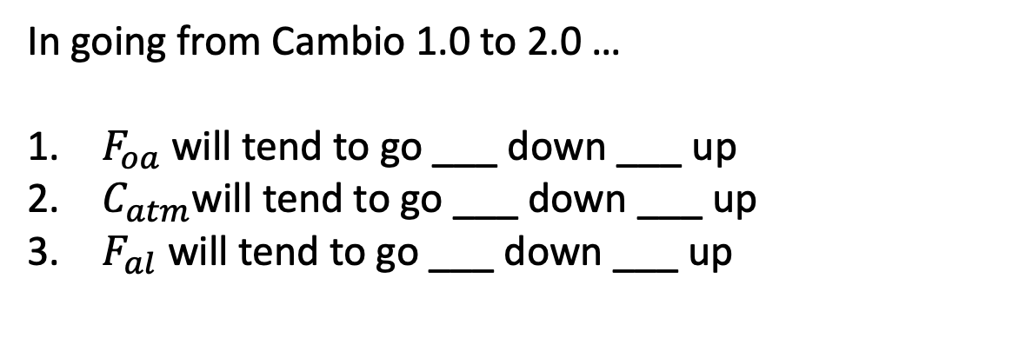

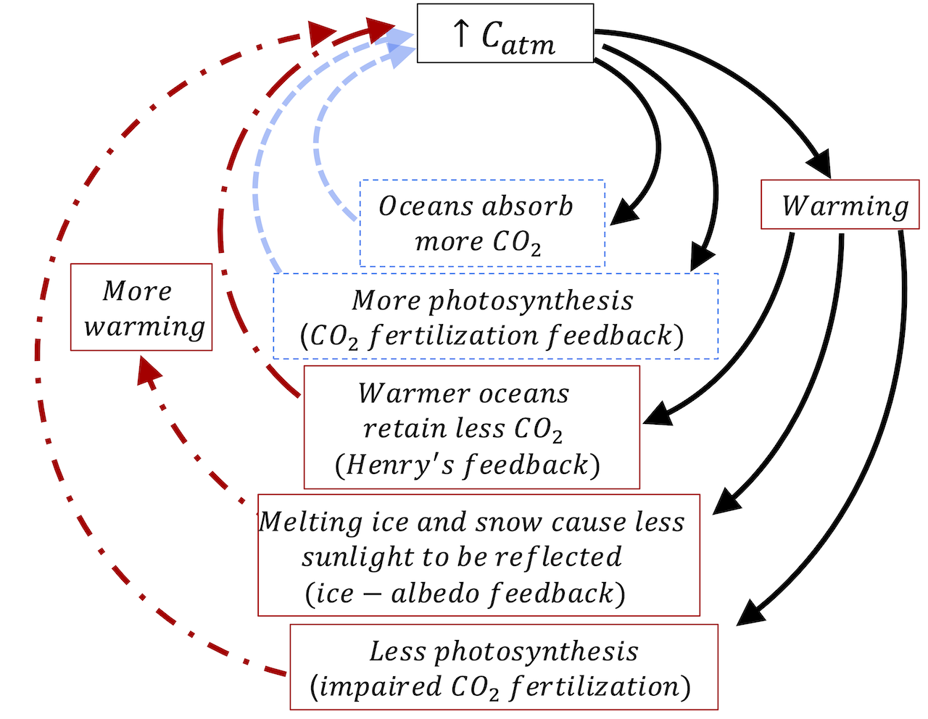
How about a little brainstorming …
Cold ocean
Warm ocean
Cold ocean
Warm ocean

Slide 5
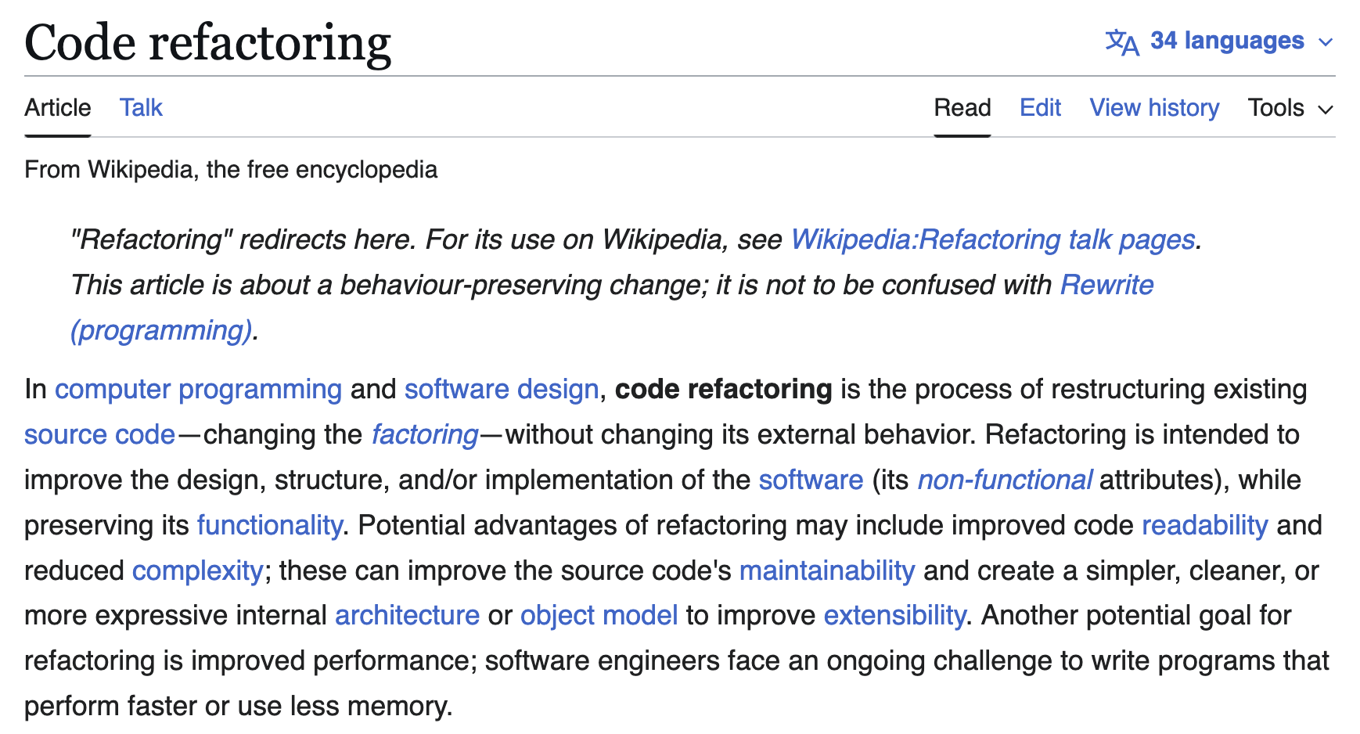
Cambio 2.0 will also be a refactoring of Cambio 1.0

Slide 6
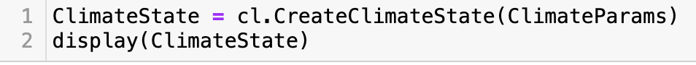
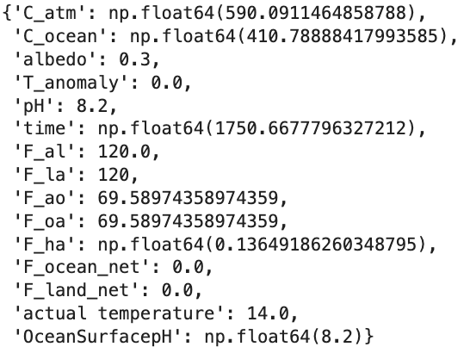
We have a new function, “CreateClimateState”, that creates a pre-industrial climate state
The climate state is actually a Python dictionary

Slide 7
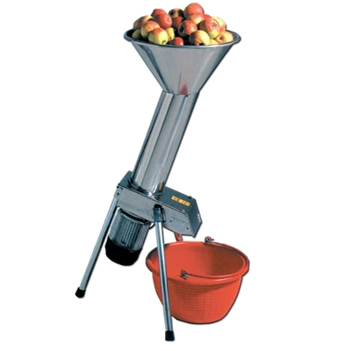
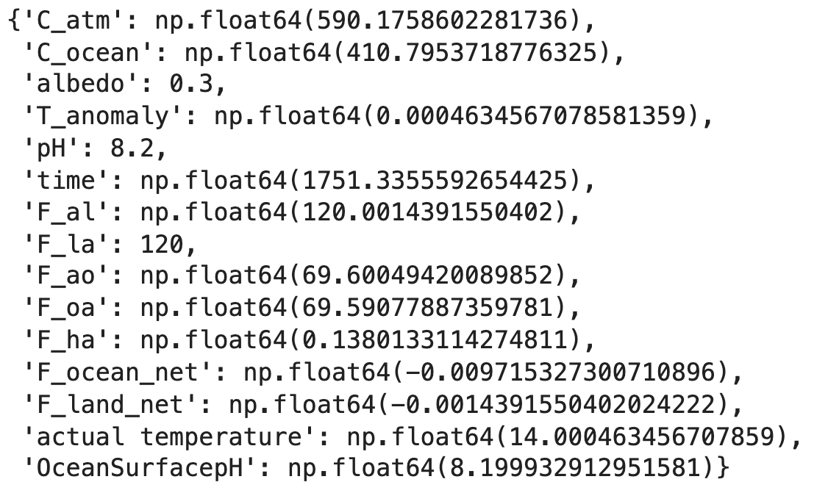
Previous climate state
“Propagator”
Climate state 0.667 years later

Slide 8
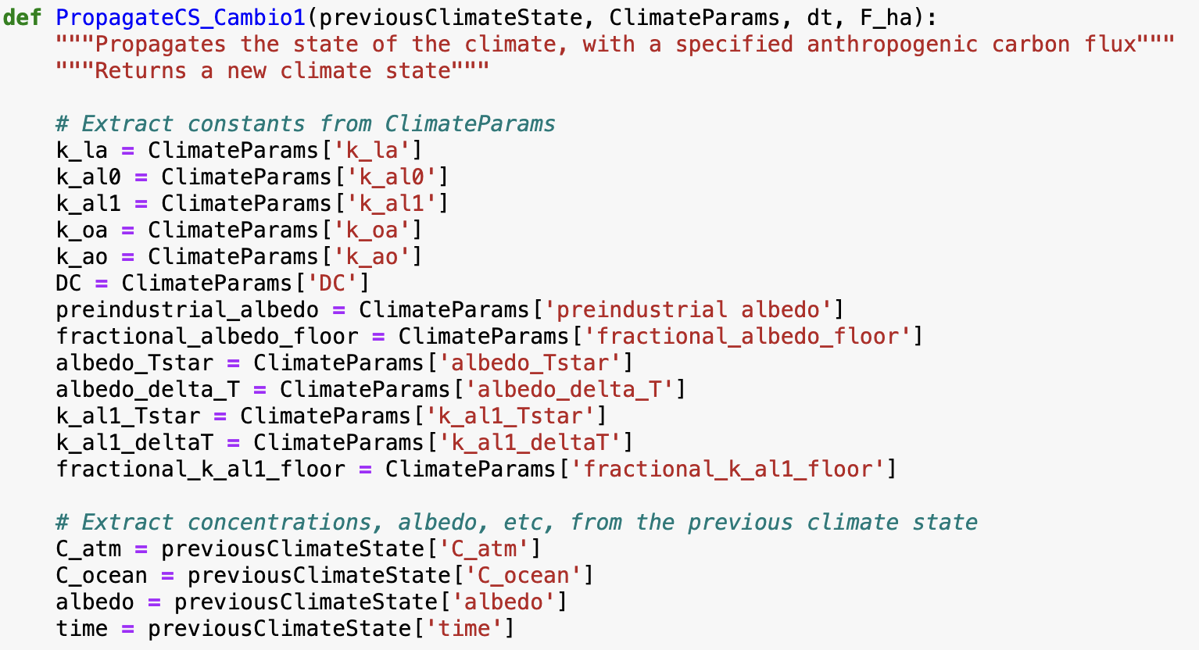
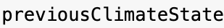
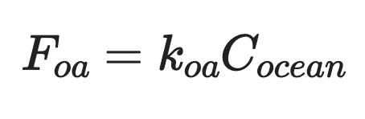

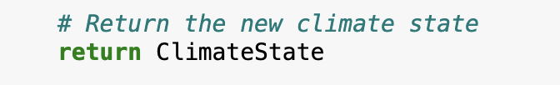
Your job will be to turn PropagateCS_Cambio1 which has this for Eq. 3 …
PropagateCS_Cambio1
…

Slide 9
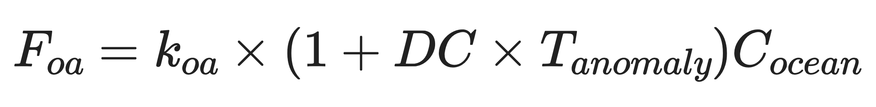
… into PropagateCS_Cambio2, which has this for Eq. 3
PropagateCS_Cambio2
…
Notes:
DC is a positive constant that determines how Henry’s law equilibrium changes with temperature

Slide 10
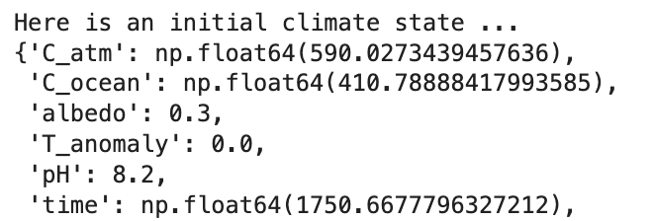
Wouldn’t it also be great to have a function that does this over and over again?
A Python list of climate states

Slide 11
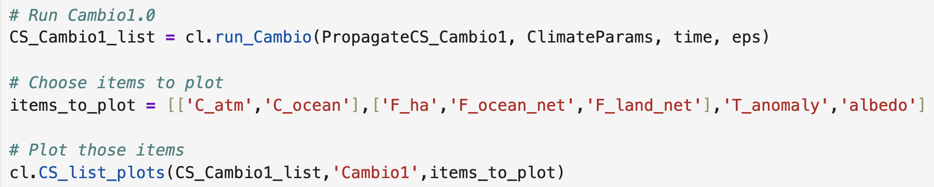
Wouldn’t it also be great to have a function that does this over and over again?
A Python list of climate states
Notice that one of the inputs to cl.run_Cambio is a propagator function!

Slide 12
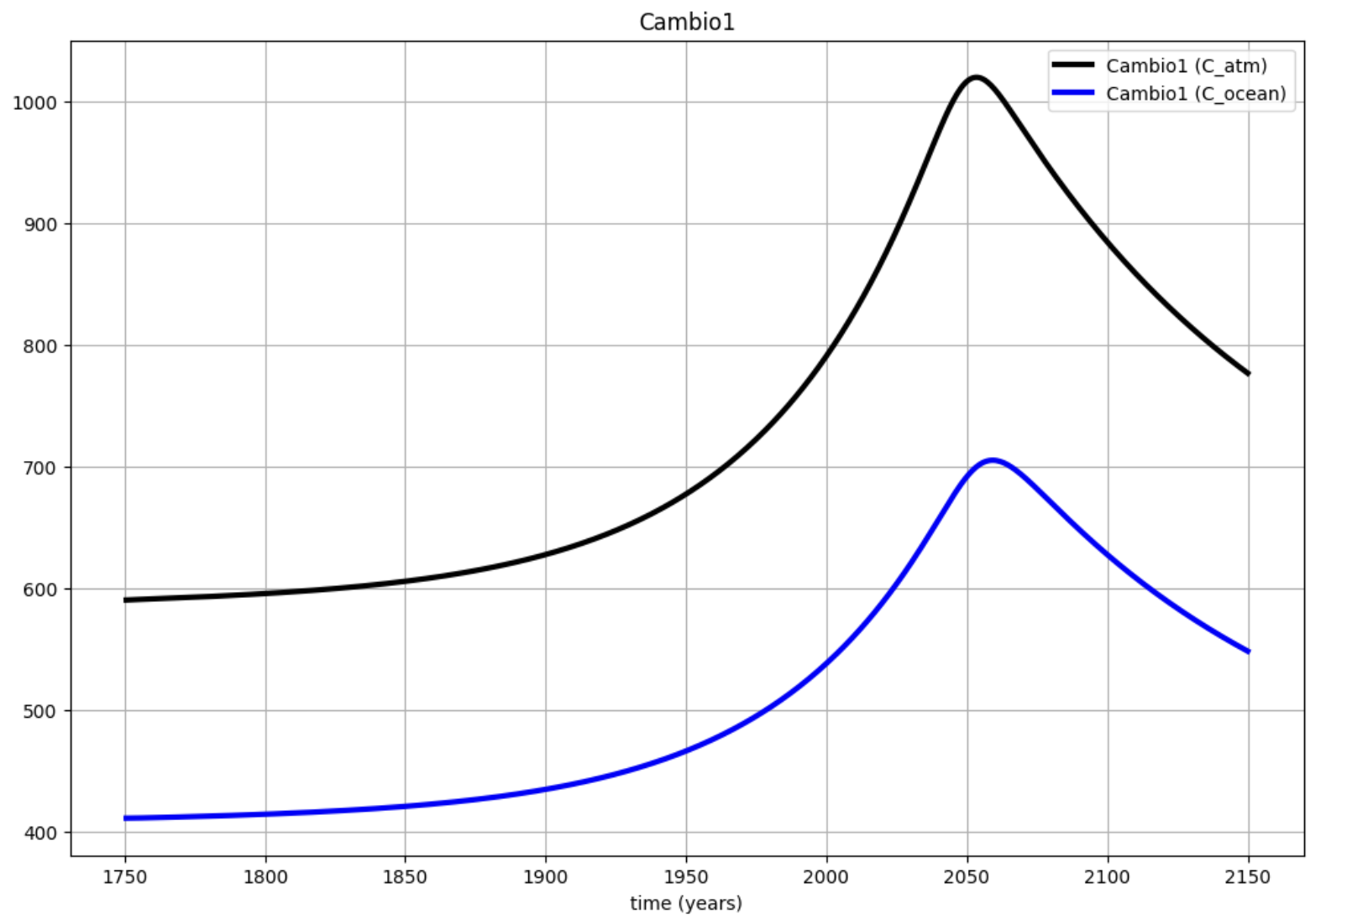
And graph the variables in that list?
A Python list of climate states

Slide 13
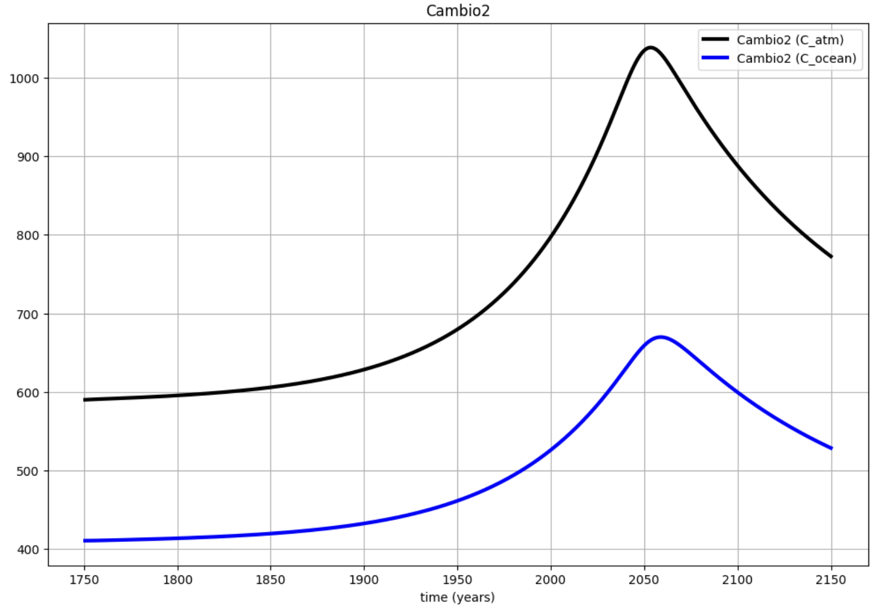
Once you’ve written PropagateCS_Cambio2, you can just plug it into cl.run_Cambio
A Python list of climate states

Slide 14
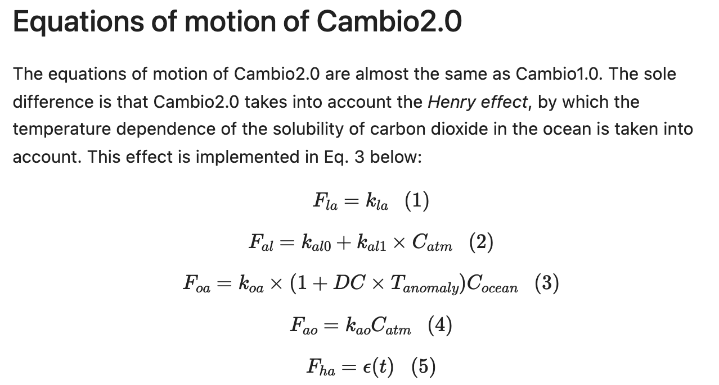

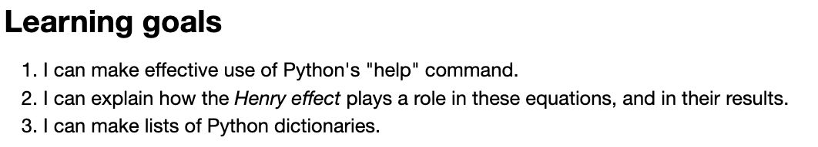
OK, let’s get started
Cold ocean
Warm ocean
Notes:
Predict the temperature if CO2 continues to rise. If we reduce CO2 emissions to zero.

